Slide 1
Week 2
Applications of Word Embeddings

Slide 2
Topics covered in week 1
Sparse vs. dense vectors
Word Embeddings
Skip-gram model
CBOW model
Applications of word embeddings
POS tagging
Named Entity Recognition(NER)

Slide 3
Session Agenda
Understanding word embeddings
Semantics in word embeddings
Word embeddings model
Application of word embeddings

Slide 4
Word Representations: Sparse vs. Dense
Term-document matrix or Term-term matrix
Given a fixed vocabulary, we count the number of times each word occurs in a document for all documents. This matrix is the term-document matrix.
We count the number of times a each word pair occurs in the document for a given vocabulary, resulting matrix is the term-term matrix.
Tf-Idf vectors
Tf-idf is similar to term-document matrix with each word occurrence count divided by inverse document matrix.
One-hot encoding of words.
Above representations of documents are sparse since most of the elements in the matrix will be zero.
These representations do not take into account individual word relationships.

Slide 5
Word Embeddings: Word2Vec
Word2Vec introduces an approach to learn word embeddings from the data.
Word embeddings learned from this approach are dense and encode semantics between words.
One-hot encodings are orthogonal to each other therefore words like king and queen have zero similarity. Word2Vec on the other hand provides us with dense embeddings that understand the similarity between king and queen.
There are two methods to train your own Word2Vec model.
Skip-gram
CBOW

Slide 6
Skip-gram Model
CBOW Model
We’ll train our model on a fake task described below,
Given a specific word in the middle of a sentence (the input word), look at the words nearby and pick one at random. The network is going to predict the probability for every word in our vocabulary of being the “nearby word” that we chose.
“Nearby” is defined on the basis of a window size.
We’ll train our model on a fake task described below,
Given nearby words to the input words, the network is going to predict the probability of input word.

Slide 7
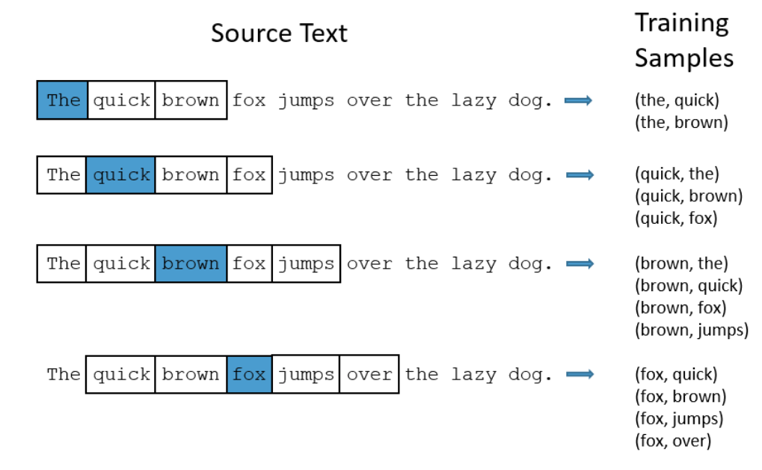
Training Sample Generation
Source: http://mccormickml.com/2016/04/19/word2vec-tutorial-the-skip-gram-model/

Slide 8
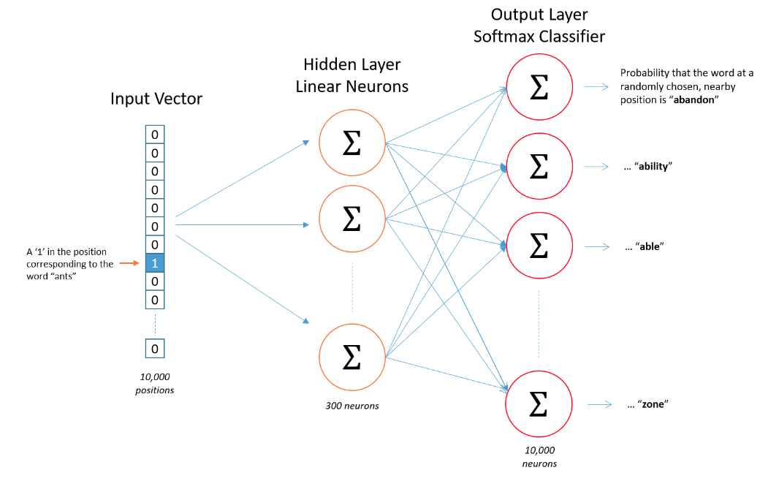
Skip-gram Model
Source: http://mccormickml.com/2016/04/19/word2vec-tutorial-the-skip-gram-model/

Slide 9
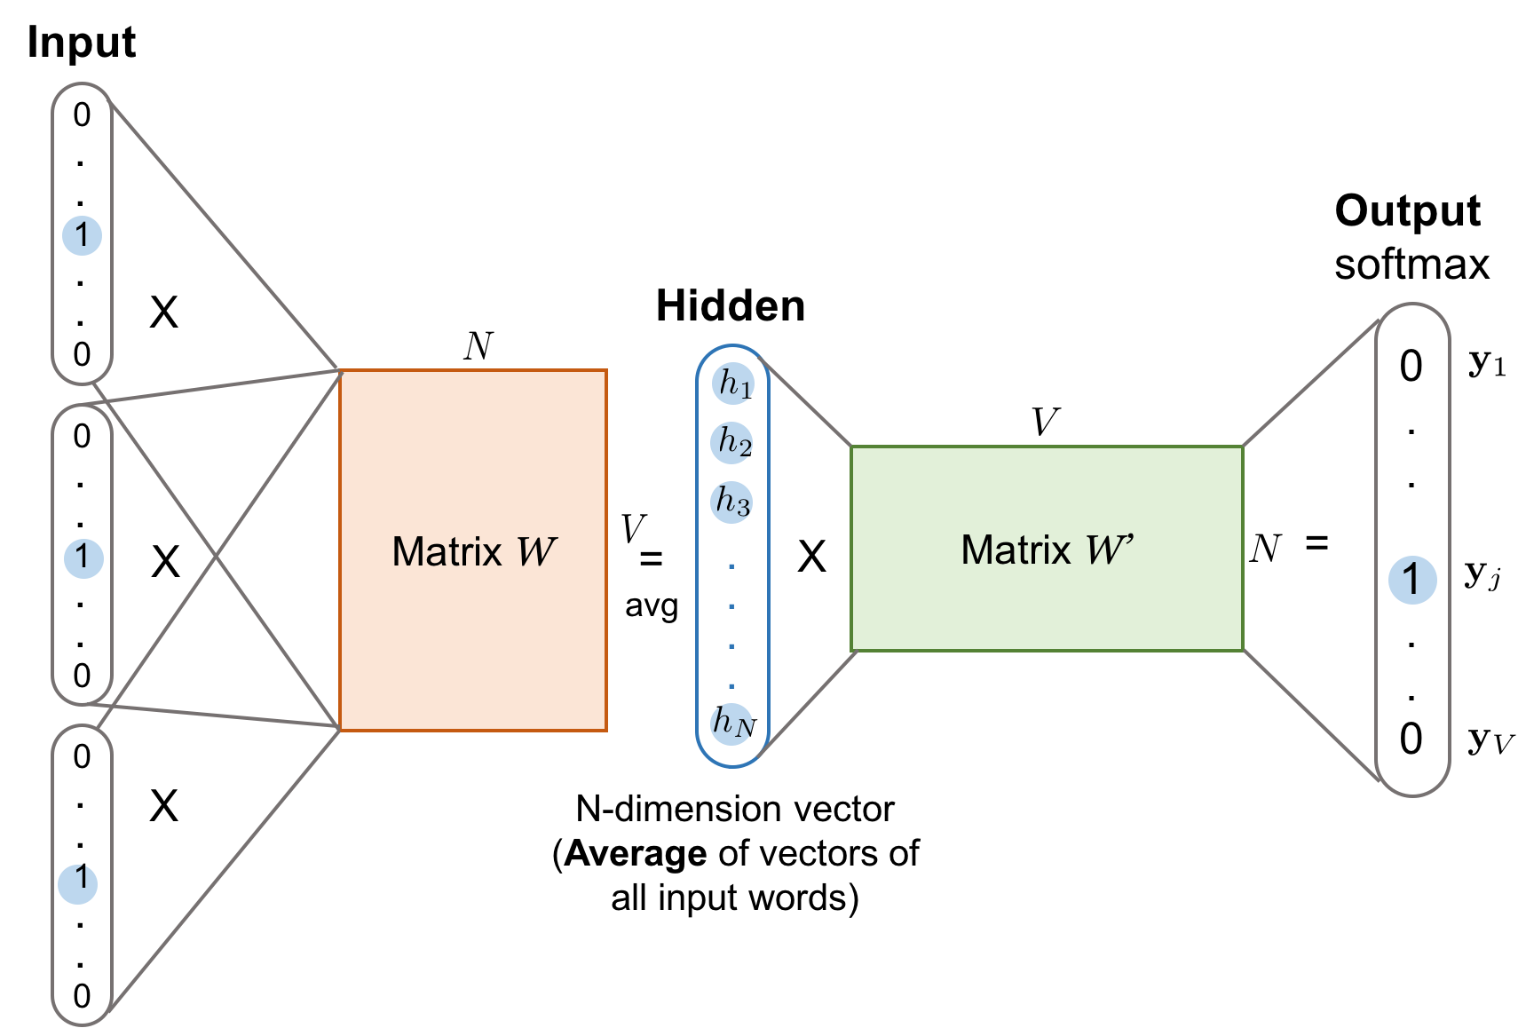
CBOW Model
Source: https://lilianweng.github.io/lil-log/2017/10/15/learning-word-embedding.html

Slide 10
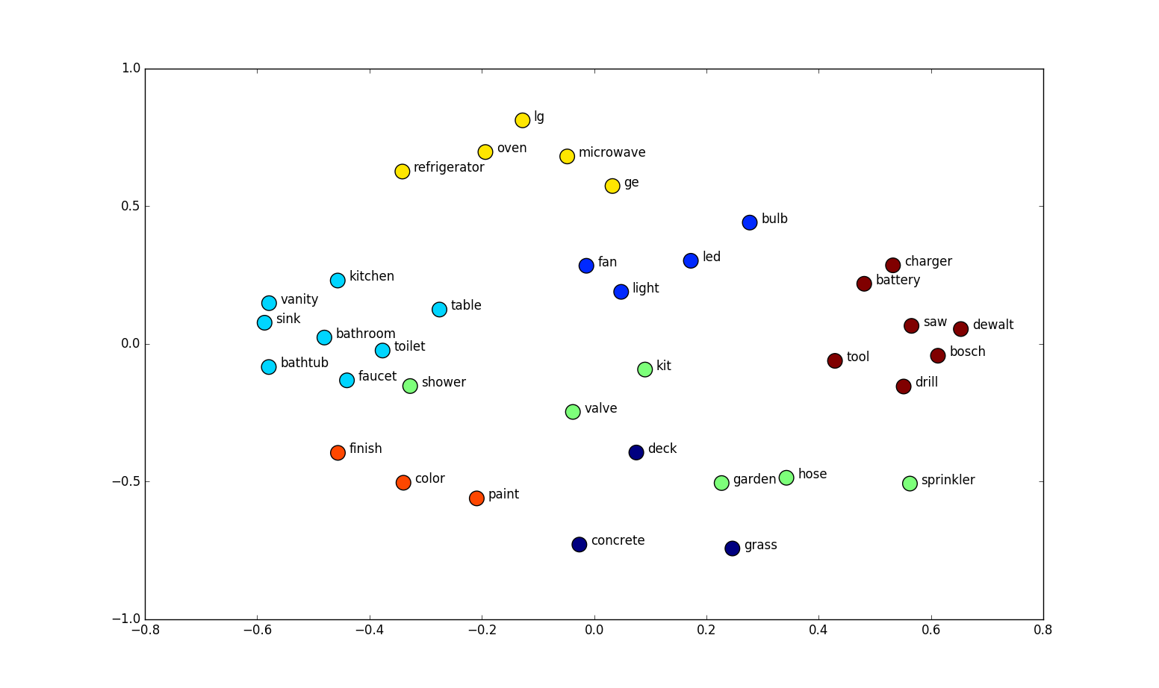
Word Semantics
Words belonging to same super-category are close to each other in word2vec space.
This similarity in word2vec space encodes the semantic relationships between words.
Source: https://www.shanelynn.ie/get-busy-with-word-embeddings-introduction/

Slide 11
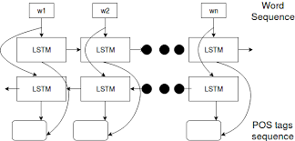
POS Tagging and NER
W1, w2, …, wn are the input word vectors.
The adjacent figure is an example of word embeddings being used as input to an bidirectional LSTM model.(to be covered later)
The output for each time step is the corresponding POS tag.
In a similar manner named entity can be predicted for each word in input sequence.

Slide 12


AIML @WORK
PGPAIML @ Great Learning
Enabling Learners to Apply the AI/ML Concepts at Work
Apply AIML at your workplace to gain some instant benefits:
Get noticed by your management with your outstanding analysis backed by data science.
Create an impact in your organization by taking up small projects/initiatives to solve critical issues using data science.
Network with members from the data science vertical of your organization and seek opportunities to contribute in small projects.
Share your success stories with us and the world to position yourself as a subject matter expert in data science.
AIML Operations | AIMLAW
@Great Learning Proprietary Content. All rights reserved. Unauthorized use or distribution prohibited

